Slide 1
PERCENTAGE
SOFT SKILLS – I
COURSE CODE : 18SSK211

Slide 2


PROBLEMS
If 25 percent of a number is 10, then what is 75 percent of the number?
Solution :
Let the number be x.
$$\frac{1}{4}×X=10$$
X = 40.
$$\frac{3}{4}×40=30.$$
Solution :
Let the number be X.
$$\frac{1}{4}×X=75$$
X = 300.
If 25% of a number is 75, then 45% of that number is:
$$\frac{45}{100}=\frac{9}{20}×300$$
135.

Slide 3

PROBLEMS
Solution :
Let the number be X.
$$\frac{2}{5}×\frac{1}{3}×\frac{3}{7}×X=15$$
$\frac{2}{5}×X=15$×7
40% of X = 105
Solution :
Let’s take Suresh salary be Rs. 100.
Two-fifth of one-third of three seventh of a number is 15. What is 40% of that number?
If Ramesh gets 10% more salary than Suresh, then Suresh get
10% less than Ramesh B. 9 1/11% more than Ramesh
C. 9 1/11% less than Ramesh D. Cannot be determined

Slide 4

PROBLEMS
Ramesh will get Rs. 110 as salary (10% of Rs, 100 = Rs. 10)
Percentage Decrease = $\frac{10}{110}×100=9\frac{1}{11}\%.$
(OR)
By product constancy method, 10% ↑ means 9$\frac{1}{11}\%↓$.
Solution :
Given that there are 3 fours and 8 sixes.
3×4 = 12, 8×6 = 48, Total = 48 + 12 = 60
Running between the wickets = 110-60 = 50
Required percentage = $\frac{50}{110}×100$
$=45\frac{5}{11}$%
A batsman scored 110 runs which included 3 boundaries and 8 sixes. What percent of his total score did he make by running between the wickets?

Slide 5

PROBLEMS
Solution :
Percentage change = $\frac{400000}{2000000}×100$
= 20%.
Solution :
Let’s Anil salary be Rs. 100
Money spent on Rent = 40% of 100 = Rs. 40.
Money spent on medicines = 30% of (100-40)
The profit made by a company in the present year is 20 lakhs. Two years ago, the profit made by the same company was 16 lakhs. What is the percentage change in the profit made by the company?
Anil spends 40% of his income on rent, 30% of the remaining on medicines and 20% of the remaining on education. lf he saves Rs.840 every month, then find his monthly salary.

Slide 6


PROBLEMS
= 3/10 (60) = Rs. 18
Money spent on education = 20% of (60-18)
=1/5 (42) = Rs. 8.40
Anil saves 100- (40 + 18 + 8.40) = Rs. 33.60
100 ---------> 33.60
? ---------> 840
X = $\frac{840×100}{33.60}=2500.$
Solution :
Given Party A, = 12% more than Party B.
Party B= 1,32,000 votes.
$\frac{80}{100}\left(\frac{70}{100}\left(\frac{60}{100}x\right)\right)$ = 840
X= 2500
OR
In an election contested by two parties, Party A secured 12% of the total votes more than Party B. If party B got 132,000 votes, by how many votes did it lose the election?

Slide 7

PROBLEMS
Let X% be the percentage of votes secured by Party B.
Party A = x + 12
X + X + 12 = 100
2X = 88
X= 44%
Party A secured 56%.
Let Y be the total votes secured.
$$\frac{44}{100}×Y=1, 32, 000$$
Y = 3,00,000.
12% of 3,00,000 => $\frac{12}{100}×3,00,000$ = 36,000.
Shortcut:
44% = 1,32,000
1% = 3000
12% = 36000

Slide 8

PROBLEMS
Solution :
Given the ratio as 6 : 7 : 8 : 9 : 10.
6x : 7x : 8x : 9x : 10x
Total = 6x + 7x + 8x + 9x + 10x = 40x
Maximum mark for five subjects = $\frac{40x}{0.6×5}=13.33x$
Hence, % of first subject = $\frac{6x}{13.33x}×100=45.01\%$
% of second subject = $\frac{7x}{13.33x}×100=52.51\%$
Therefore, 8x, 9x, 10x should also more than 50%.
The answer is 4 Subjects.
A student took five papers in an examination, where the full marks were the same for each paper. His marks in these papers were in the proportion of 6 : 7 : 8 : 9 : 10. In all papers together, the candidate obtained 60% of the total marks. Then, the number of papers in which he got more than 50% marks is:

Slide 9

PROBLEMS
Solution :
$100\underset{→}{\begin{aligned}30\%↑ \\ +30 \end{aligned}} 130 \underset{→}{\begin{aligned}20\%↓ \\ −26 \end{aligned}}$104
Solution :
If the value of R% is different, we have to use this formula.
$$A=P\left(1±\frac{x}{100}\right)\left(1±\frac{y}{100}\right)\left(1±\frac{z}{100}\right)$$
The price of a Maruti car rises by 30% while the sales of the car comes down by 20%. What is the percentage change in the total revenue?
4% Increase
If the annual increase in the population of the town is 5% & 10% for 2 successive years and the present population is 28875, what was it two years ago?
x, y and z are different percentage values

Slide 10

PROBLEMS
Population 2 years ago = $\frac{Present population(P)}{\left(1±\frac{x}{100}\right)\left(1±\frac{y}{100}\right)}$
$=\frac{28875}{\frac{105}{100}×\frac{110}{100}}$
= 25000.
Solution :
Given, X% on first 2000Rs and Y% on the rest.
X% of 2000 + y% of 2000 = 700 -----------------(1)
X% of 2000 + Y% of 3000 = 900 -----------------(2)
Y% of 1000 = 200
Y = 20%
Substitute Y in Eqn (1), X = 15%.
A man earns x% on the first Rs. 2,000 and y% on the rest of his income. If he earns Rs. 700 from Rs. 4,000 and Rs. 900 from Rs. 5,000 of income, find x%?

Slide 11

PROBLEMS
Solution :
Fresh Grapes Dry Grapes
90% water 20% water
10% pulp 80% pulp
20 kg -> $\frac{10}{100}×20=2 kg$
$$\frac{80}{100}×x=2$$
x = 2.5 kg. (Total weight of dry grapes)
Fresh grapes contain 90% water by weight while dried grapes contain 20% water by weight. What is the weight of dry grapes available from 20 kg of fresh grapes?

Slide 12
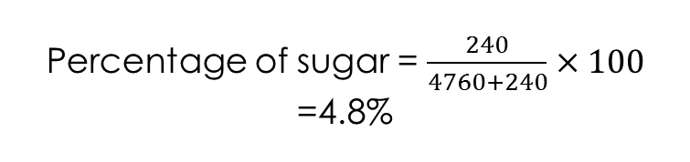
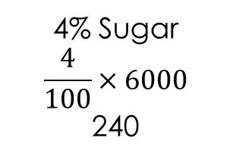
PROBLEMS
Solution :
We know that, 1 litre = 1000 ml
A litre of water is evaporated from 6 litre of sugar solution containing 4% of sugar. Find the percentage of sugar in the remaining solution?
6000
96% water
6000-240
5760
4% Sugar
$$\frac{4}{100}×6000$$
240
5760-
1000
4760
Percentage of sugar = $\frac{240}{4760+240}×100$
=4.8%

Slide 13
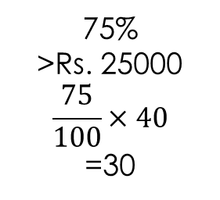
PROBLEMS
Solution :
Required fraction = 15/60 = ¼.
Forty per cent of employees of a certain company are men and 75% of the men earn more than Rs. 25,000 per year. If 45% of the company’s employees earn more than Rs. 25,000 per year, what fraction of the women employees of the company earn more than Rs. 25,000 per year?
Total people (100)
Men (40)
40%
Men(40)
60% women(60)
75%
>Rs. 25000
$$\frac{75}{100}×40$$
=30
25%
<Rs. 25000
15
Given (45% earn more than 25000)

Slide 14


